Slide 1

multiplex social network analysis with R
Matteo Magnani
InfoLab, Dept. of Information Technology
Uppsala University
http://infolab.it.uu.se @uuinfolab
matteo.magnani@it.uu.se @matmagnani
Luca Rossi
Networks, Data & Society
IT University of Copenhagen
http://nerds.itu.dk @nerdsitu
lucr@itu.dk @LR
^{This work was} partially supported by the European Community through the project “Values and ethics in Innovation for Responsible Technology in Europe” (Virt-EU) funded under Horizon 2020 ICT-35-RIA call Enabling Responsible ICT-related Research and Innovation.

Slide 2
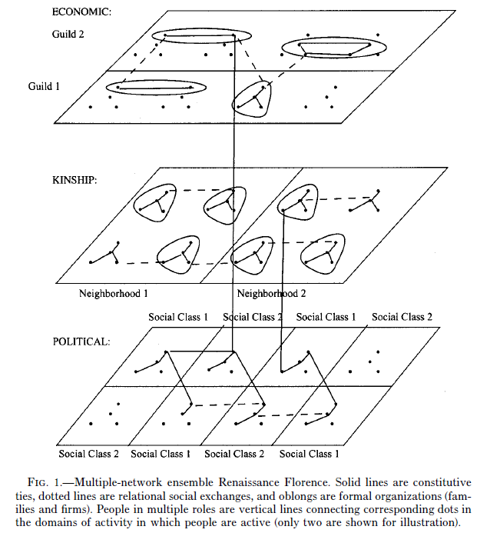
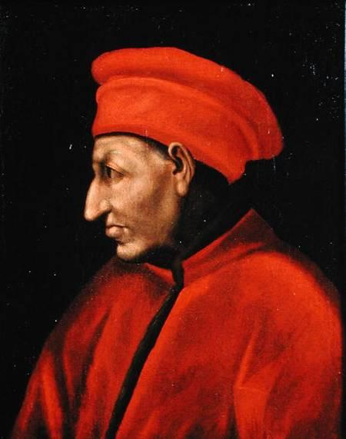
J F Padgett & P D McLean (2006) Organizational Invention and Elite Transformation: The Birth of Partnership Systems in Renaissance Florence. American Journal of Sociology Volume 111 Number 5
Moreno, J L. 1934. Who Shall Survive? A New Approach to the Problem of Human Interrelations.

Slide 3
Multiplex networks as multilayer networks
One actor
edge
vertex
Two edge types (layers)

Slide 4
Multiplex networks as multilayer networks
Multi-relational networks
(collaboration, leisure, bullying, knowledge exchange, …)
Connections on different social network platforms
(Twitter, YouTube, Facebook)
Different types of connections on the same platform
(follow, RT, reply, mention, like)
Topical conversational networks
(one topic per layer)
(see: Temporal Text Networks)

Slide 5
Expected learning outcomes
At the end of this workshop you should be able to:
Qualitatively explore a multiplex network.
Visualization of structure and attributes.
Understand the relationship between edge types.
Layer comparison methods.
Identify the most important actors wrt their degree.
Degree / degree deviation.
Neighborhood / x-neighborhood.
Layer relevance.
Discover communities.
Generate synthetic multiplex networks (if time allows).

Slide 6
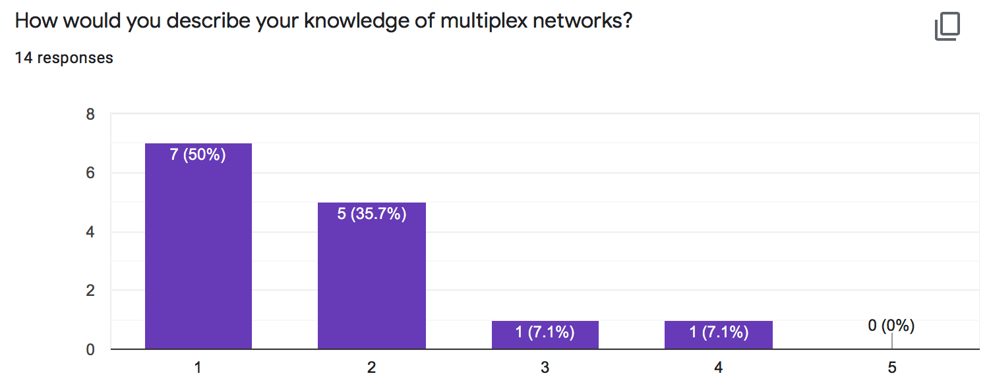
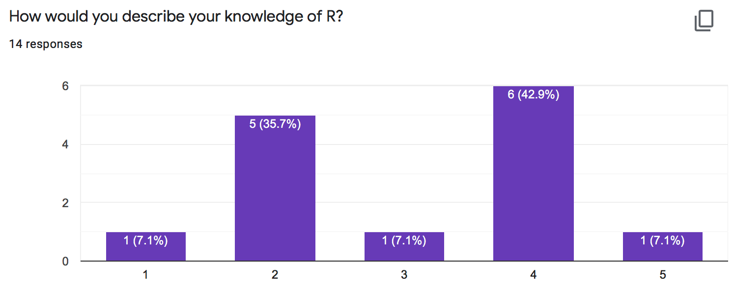
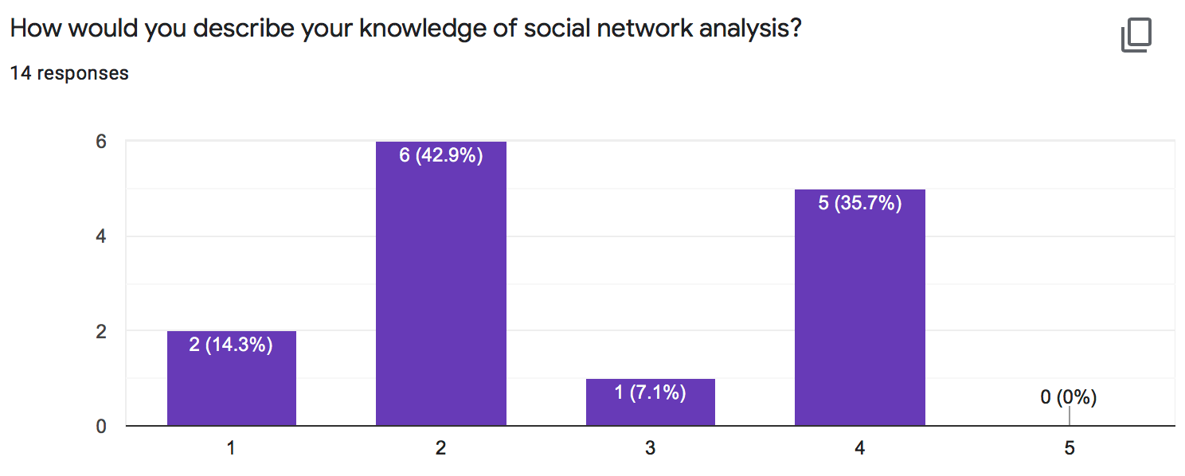

Slide 7
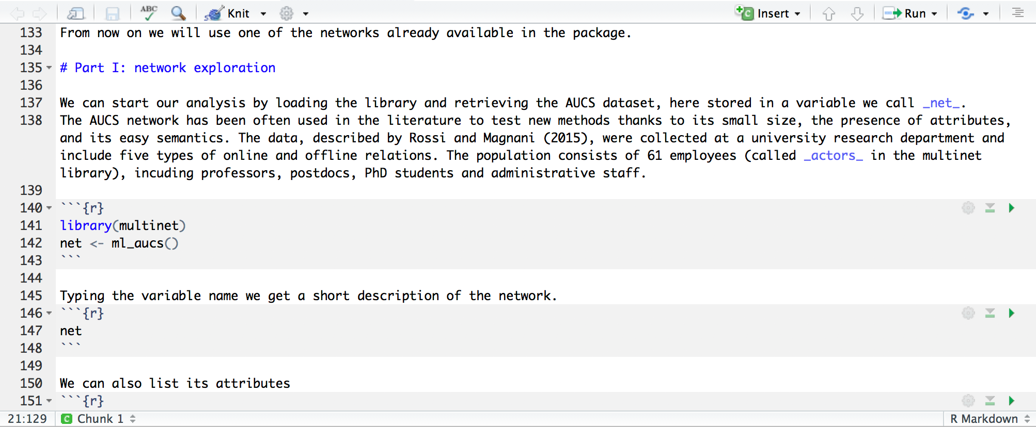
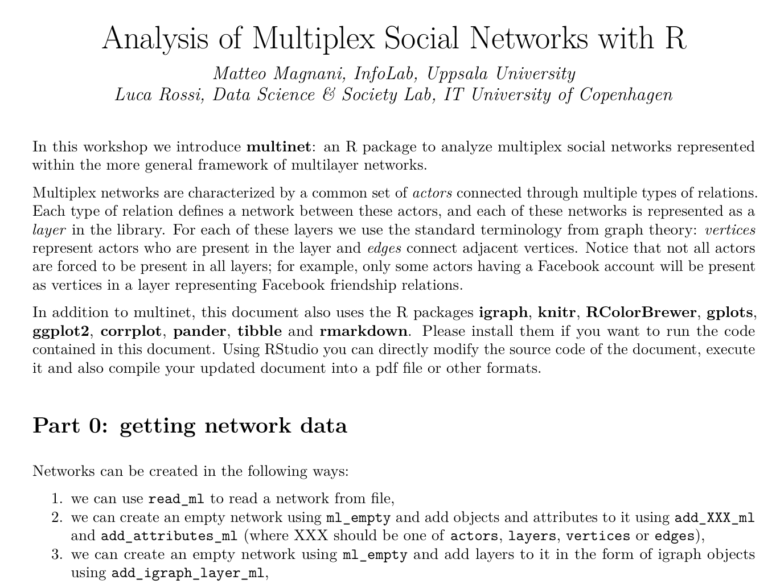
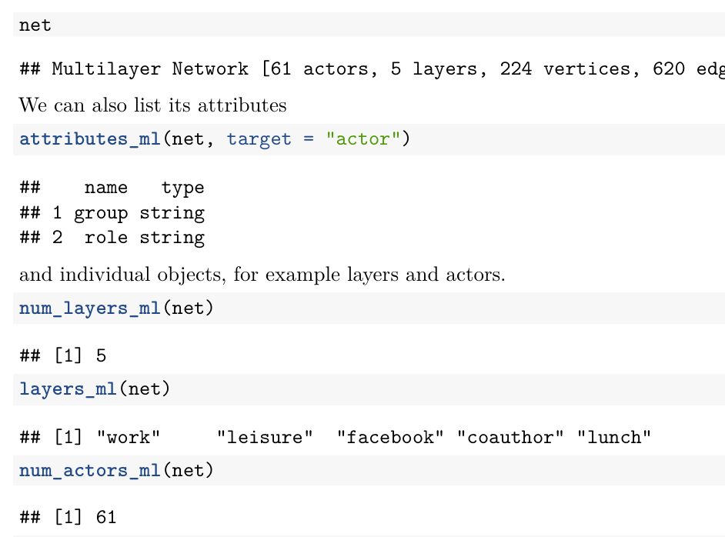
workshop.Rmd
workshop.pdf

Slide 8
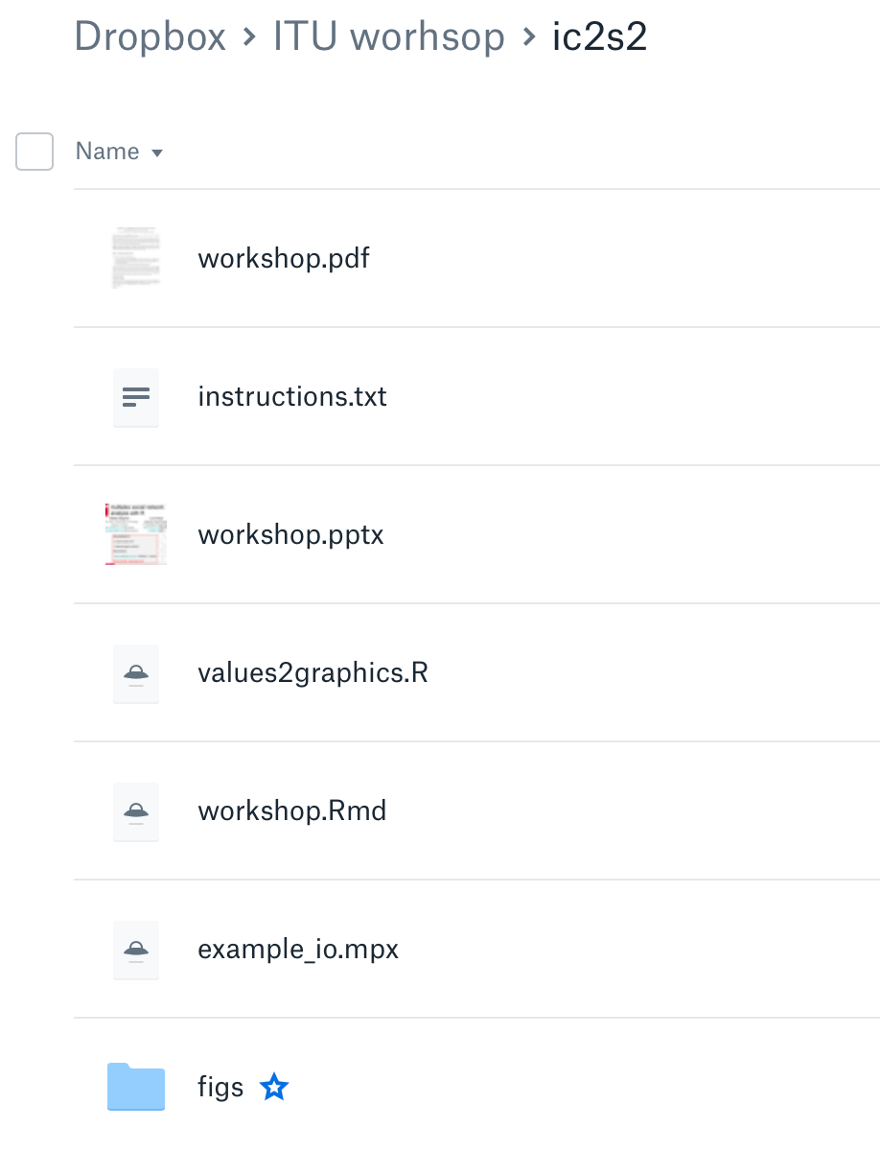
Before we start
Requirements
R
multinet library
install.packages("multinet")
library(multinet)
(Rstudio)

Slide 9
Method
Quick explanations of the concepts.
Followed by some practical tasks.
For some tasks: we provide the code, you execute it.
For some tasks: you write the code.
Followed by some interpretation / discussion.
You get the workshop documentation as an editable Rmarkdown file.

Slide 10
Getting started
Part 0

Slide 11
Getting network data
Networks can be created in the following ways:
Pre-loaded networks.
With read_ml().
With ml_empty()
add_igraph_layer_ml().
add_XXX_ml() + add_attributes_ml().
XXX: layers, vertices or edges.
With grow_ml().

Slide 12
Input file format (basic)
read_ml("file-name")
Matteo, Luca
Matteo, Davide
Luca, Matteo
Matteo, Luca, work
Matteo, Davide, work
Luca, Matteo, friendship
Davide
Davide
Matteo
Matteo
work
Luca
Luca
Matteo
friendship
Luca

Slide 13
Input file format (full)
#TYPE multiplex
#LAYERS
research, UNDIRECTED
twitter, DIRECTED
#ACTOR ATTRIBUTES
affiliation, STRING
#VERTEX ATTRIBUTES
twitter, num_tweets, NUMERIC
#EDGE ATTRIBUTES
research, num_publications, NUMERIC
#ACTORS
Luca,ITU
Matteo,UU
Davide,UU
#VERTICES
Luca,twitter,53
Matteo,twitter,13
#EDGES
Luca,Matteo,research,9
Luca,Matteo,twitter
?multinet.IO

Slide 14
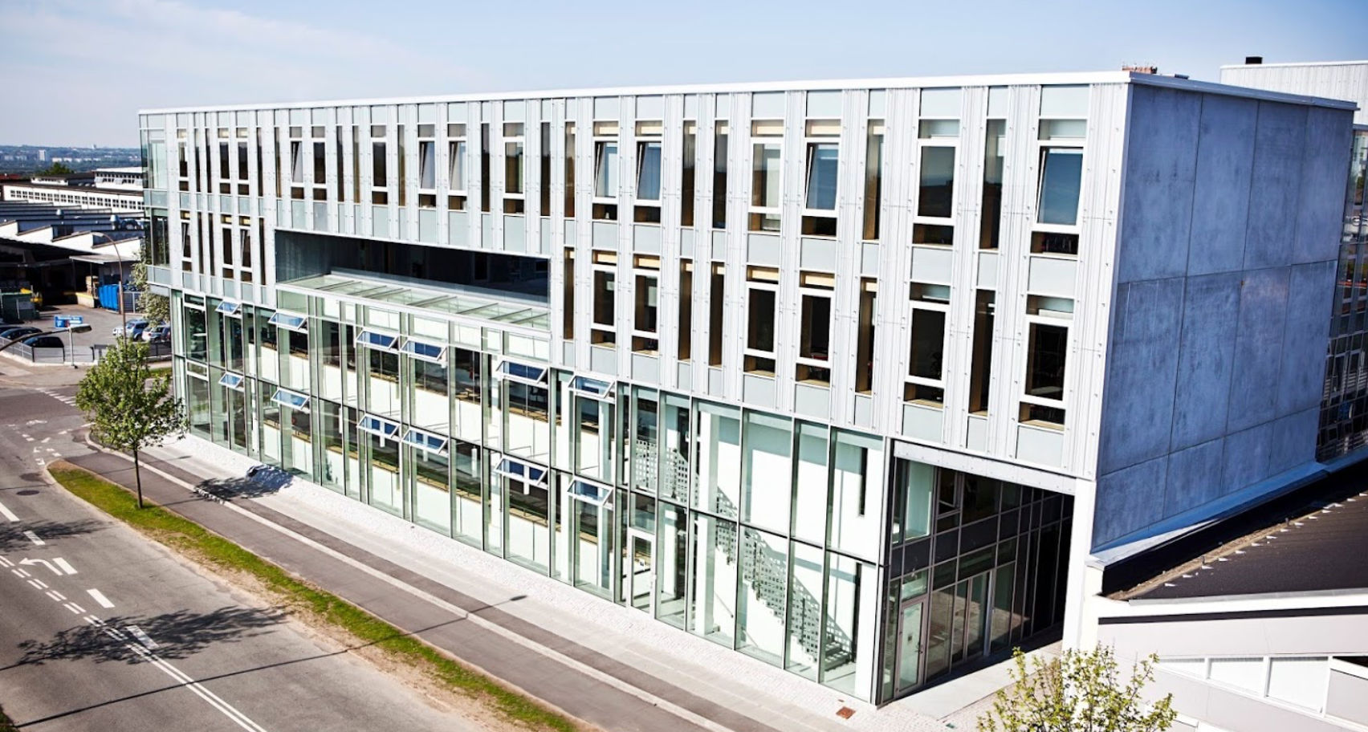
Our working example: AUCS
library(multinet)
net <- ml_aucs()
net
layers_ml(net)
actors_ml(net)
vertices_ml(net)
edges_ml(net)
attributes_ml(net, target = "actor")

Slide 15
Getting an overview
Part 1

Slide 16
Force-based layout
w_in
vertex repulsion
vertex attraction through edges
gravity
w_inter
w_in
vertex repulsion
vertex attraction through edges
gravity

Slide 17
Force-based layout
in
inter

Slide 18
A first visualization
plot(net)
l <- layout_multiforce_ml(net, w_inter = 0, gravity = 1)
plot( net,
vertex.labels = "", grid = c(2,3),
layout = l,
legend.x="bottomright”, legend.inset = c(.05,.05) )

Slide 20
Tasks
Plot the network coloring the vertices (actors) according to their role.
Observe and interpret the result. What are you learning about this network?
Do the same visualizing the research group instead of the role.

Slide 21
Plotting vertex attributes
vertices_ml(net)
vertices_ml(net)[[1]]
get_values_ml(…)
actor | layer
U49 | leisure
U142 | coauthor
U62 | leisure
U23 | leisure
U23 | lunch
actor
U49
U142
U62
U23
U23
value
PhD
PhD
Postdoc
PhD
PhD
#A6CEE3
#A6CEE3
#1F78B4
#A6CEE3
#A6CEE3

Slide 22
Plotting vertex attributes
role_attributes <- get_values_ml(net, actors = vertices_ml(net)[[1]], attribute = "role")
vertices_ml(net)
vertices_ml(net)[[1]]
get_values_ml(…)
actor | layer
U49 | leisure
U142 | coauthor
U62 | leisure
U23 | leisure
U23 | lunch
actor
U49
U142
U62
U23
U23
value
PhD
PhD
Postdoc
PhD
PhD

Slide 23
Plotting vertex attributes
role_attributes <- get_values_ml(net, actors = vertices_ml(net)[[1]], attribute = "role")
gr <- values2graphics(role_attributes)
gr$color
gr$legend.text
gr$legend.col
gr$legend.pch
value
PhD
PhD
Postdoc
PhD
PhD
#A6CEE3
#A6CEE3
#1F78B4
#A6CEE3
#A6CEE3
PhD
Postdoc
#A6CEE3
#1F78B4
21
21

Slide 24
Plotting vertex attributes
role_attributes <- get_values_ml(net, actors = vertices_ml(net)[[1]], attribute = "role”)
gr <- values2graphics(role_attributes[[1]])
plot( net,
layout = l,
grid = c(2,3),
vertex.labels = "",
vertex.color = gr$color
)
legend( "bottomright”,
legend = gr$legend.text,
col = gr$legend.col, pt.bg = gr$legend.col, pch = gr$legend.pch,
bty = "n", pt.cex = 1, cex = .5, inset = c(0.05, 0.05)
)

Slide 25
Roles

Slide 26
Research groups

Slide 27
Layer comparison
Part 2

Slide 28
Summary statistics
Layers can be converted (individually or in groups) into igraph networks and analyzed independently of each others.
summary () provides a comparison of all the layers in an undirected multilayer network.
Before you execute summary():
What is the layer with highest density?
What is the layer with highest clustering coefficient?

Slide 29
Summary statistics
summary ()
 | N | M | Nc | dens | Cc | Apl | Dia
Flat | 61 | 620 | 1 | .33 | .48 | 2.06 | 4
Coauthor | 25 | 21 | 8 | .07 | .43 | 1.50 | 3
Facebook | 32 | 124 | 1 | .25 | .48 | 1.96 | 4
Leisure | 47 | 88 | 2 | .08 | .34 | 3.12 | 8
Lunch | 60 | 193 | 1 | .11 | .57 | 3.19 | 7
Work | 60 | 194 | 1 | .11 | .34 | 2.39 | 4

Slide 30
d <- degree_ml(net, layers = <layername>)
hist(d, breaks = max(d, na.rm = TRUE), main=<layername>, xlab="degree")

Slide 31
Layer measures
layer_comparison_ml () can be used to compute various types of multilayer specific comparisons (e.g. the presence of the same actor on multiple layers). layer_comparison_ml(net, method="jaccard.actors")
 | Facebook | Lunch | Leisure | Work | Coauthor
Facebook | 1 | .53 | .52 | .53 | .30
Lunch |  | 1 | .78 | .97 | .42
Leisure |  |  | 1 | .78 | .42
Work |  |  |  | 1 | .42
Coauthor |  |  |  |  | 1

Slide 32
Task: layer comparison
We will compute the following layer comparisons:
jaccard.actors
Higher if many actors are common.
pearson.degree
Higher if actors have high (resp., low) degree in both layers (“popular” actors are popular in both).
jaccard.edges
Higher if actors are connected to the same individuals in both layers.
coverage.edges
Percentage of edges in one layer that are also present in the other.

Slide 33
Task: layer comparison
layer_comparison_ml(net, method=“XXXXX”)
pearson.degree
Which pair of layers has the highest value?
Which pair of layers has the lowest value?
Is the lowest value negative?
coverage.edges
Which pair of layers has the highest value?
What highest value do you expect?

Slide 34
Pearson degree

Slide 35
Coverage edges

Slide 36
Actor analysis
Part 3

Slide 37
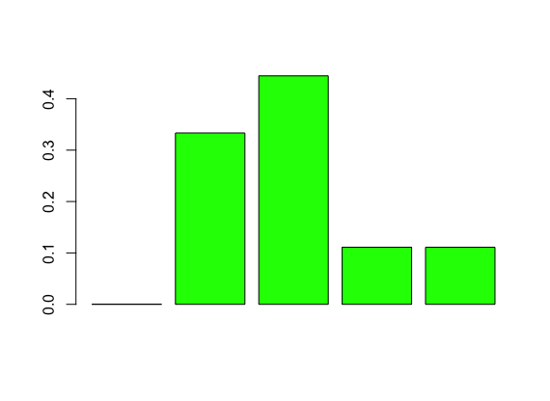
Degree
Degree of a vertex: number of adjacent edges.
2
1
4
2
2
2
1
3
1

Slide 38
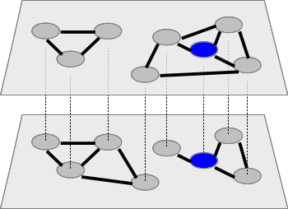
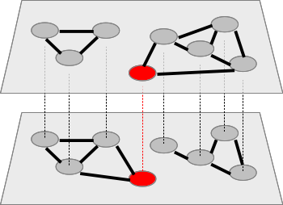
Degree and neighborhood
Degree: 3
Central
Degree: 2
Peripheral
Degree: 3
Central
Degree: 2
Peripheral
Neighbors: 3
Central
Neighbors: 4
Very central
neighborhood_ml
xneighborhood_ml

Slide 39
Task: find the “important” actors.
n <- neighborhood_ml(net)
top_values <- head( n[order(-n)] )
top_actors <- head( actors_ml(net)[order(-n)] )
n <- neighborhood_ml( net, layers = "leisure")
n <- xneighborhood_ml( net, layers = "leisure")
# You can also pass c("leisure", "work", …).
degree_deviation_ml(net, actors="U4")

Slide 40
Layer relevance
3 neighbors: relevance 100%
3 neighbors
2 neighbors: relevance 50%
4 neighbors
Notes:
What happens if I only KEEP

Slide 41
Exclusive neighbors
3 neighbors
0 x-neighbors
2 neighbors
2 x-neighbors

Slide 42
Exclusive layer relevance
3 neighbors: relevance 100%
0 x-neighbors
x-relevance: 0%
3 neighbors
2 neighbors: relevance 50%
2 x-neighbors
x-relevance: 50%
4 neighbors

Slide 43
Task: find and characterize the “important” actors.
Extract the actors with the most neighbors on the whole network.
Extract the actors with the most neighbors on each layer, or specific combinations of layers.
Given an actor, compute the relevance of each layer for this actor.

Slide 44
Task: find and characterize the “important” actors.
Extract the actors with the most neighbors on the whole network.
n <- neighborhood_ml(net)
n[order(-n)]
actors_ml(net)[order(-n)]
Extract the actors with the most neighbors on each layer, or specific combinations of layers.
neighborhood_ml( net, layers = "leisure")
Given an actor, compute the relevance of each layer for this actor.
relevance_ml( net, "U4", layers = "leisure")
xrelevance_ml( net, "U4", layers = "leisure")

Slide 45
Task: find and characterize the “important” actors.
n <- neighborhood_ml(net)
n[order(-n)]
actors_ml(net)[order(-n)]
neighborhood_ml( net, layers = "leisure")
relevance_ml( net, "U4", layers = "leisure")
xrelevance_ml( net, "U4", layers = "leisure")
# You can also pass c("leisure", "work", …).
degree_deviation_ml(net, actors="U4")

Slide 46
communities
Part 4

Slide 47
Our objective

Slide 48
A simple execution
ml_clust <- glouvain_ml(net)
l <- layout_multiforce_ml(net)
plot( net,
com = ml_clust,
…)

Slide 49
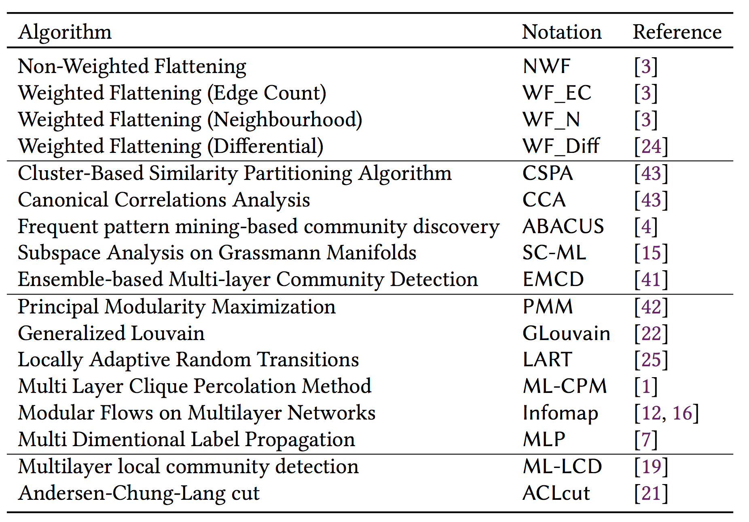

Slide 50
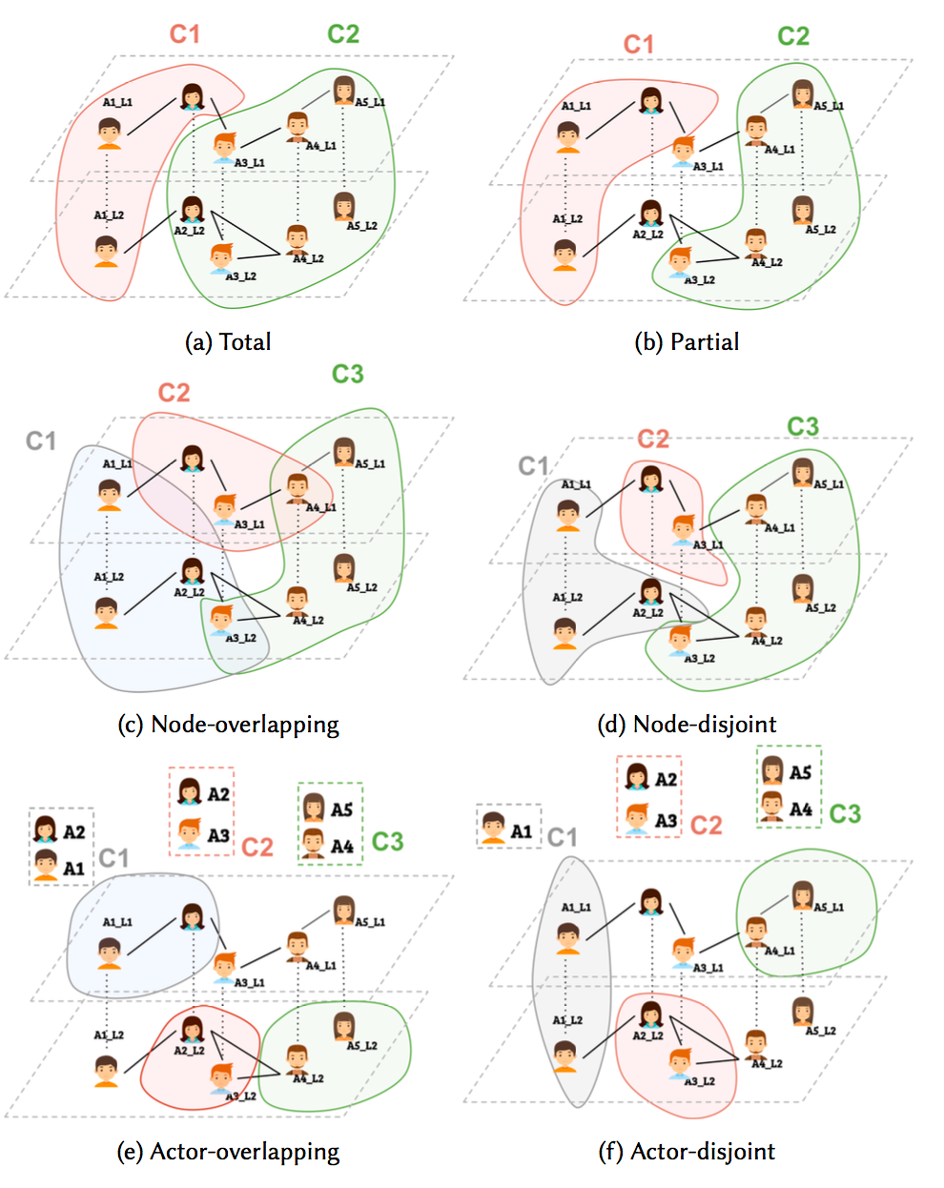

Slide 51
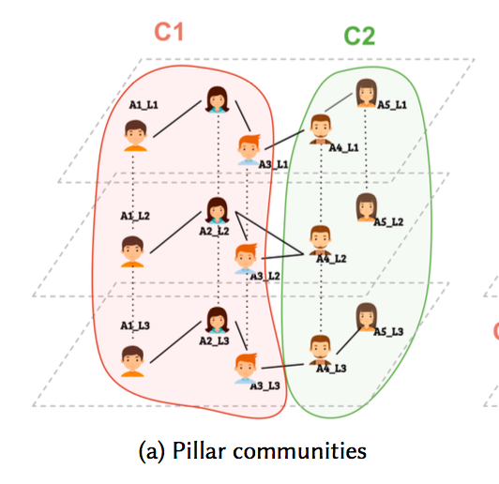

Slide 52
Modularity
Modularity is a clustering quality function introduced by Mark Newman in 2001.

Slide 53
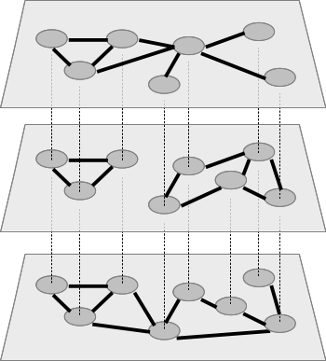
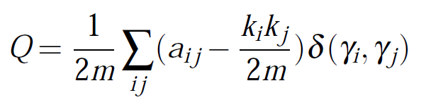
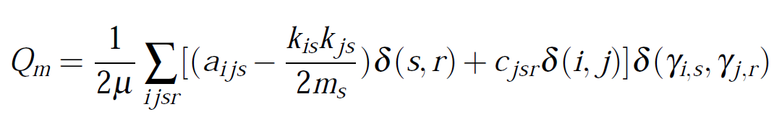
Multiplex modularity
nodes on same network
same node on different networks

Slide 54
Clique percolation method
Palla, Gergely, Imre Derényi, Illés Farkas, and Tamás Vicsek. 2005. “Uncovering the Overlapping Community Structure of Complex Networks in Nature and Society.” Nature 435 (7043).
Find max-cliques of size ≥ k
CPM(k)
Notes:
Contained

Slide 55
Clique percolation method
Find max-cliques of size ≥ k
CPM(k)

Slide 56
Clique percolation method
Adjacency: k-1 common nodes
CPM(k)

Slide 57
Clique percolation method
Find spanning trees (that is,
connected components)
CPM(k)

Slide 58
Clique percolation method
CPM(k)

Slide 59
Clique percolation method
CPM(k)

Slide 60
Clique percolation method
CPM(k)

Slide 61
Multiplex clique percolation method
CPM(k,m)

Slide 62
Task
What are the main differences between:
generalized Louvain and
multiplex clique percolation?
Theoretically, or comparing their results on AUCS.
Other functions:
abacus_ml, infomap_ml
modularity_ml

Slide 63
Network growing
Part 5

Slide 64
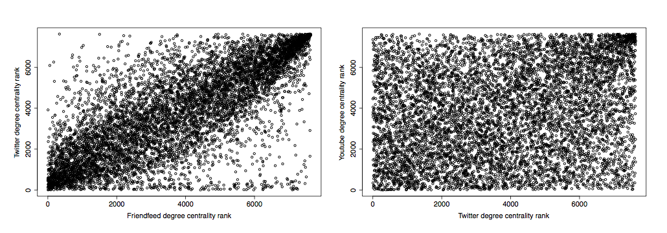


How are networks formed?
LNCS. 2013. 7812:257–264. Springer

Slide 65
L₁
+e
+e
+e
L₁
L₁
L₁
+e
+e
+e
L₂
L₂
L₂
L₂
t₀
t₁
t₂
time

Slide 66
The model in a nutshell
1. no-action.
Nothing happens, i.e., the network remains unchanged.
2. internal-growth.
The network grows according to internal dynamics, i.e., something happens independently of the other networks.
3. external-growth.
The network grows according to external dynamics, i.e., something happens because of the configuration of an external network.

Slide 67
Network growing with multinet
models_mix <-
c(evolution_pa_ml(3,1), evolution_er_ml(100), evolution_er_ml(100))
pr.external <- c(0,.8,0) pr.internal <- c(1,.2,1) dependency <- matrix(c(1,1,0,0,0,0,0,0,1),3,3)
ml_generated_mix <- grow_ml(
100,
100,
models_mix,
pr.internal,
pr.external,
dependency)

Slide 68
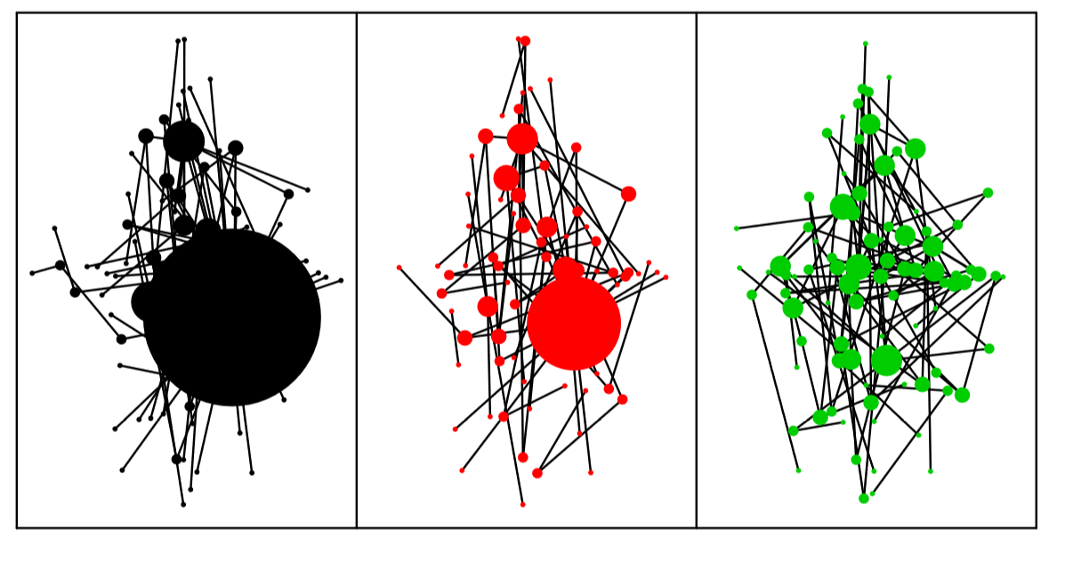
PA (int=1, ext=0)
ER (int=.2, ext=0.8)
ER (int=1, ext=0)

Slide 69

Mikko Kivelä, Alexandre Arenas, Marc Barthelemy, James P. Gleeson, Yamir Moreno, and Mason A. Porter. 2014. “Multilayer Networks.” Physics and Society. Journal of Complex Networks 2 (3).
Stefano Boccaletti, Ginestra Bianconi, Regino Criado, Charo I. Del Genio, Jesús Gómez-Gardeñes, Miguel Romance, Irene Sendiña-Nadal, Zhen Wang, and Massimiliano Zanin. 2014. “The Structure and Dynamics of Multilayer Networks.” Physics Reports 544 (1).
Ginestra Bianconi. Multilayer Networks: Structure and Function. Oxford University Press. 2018.
http://multilayer.it.uu.se
(on diffusion/propagation) Mostafa Salehi, Rajesh Sharma, Moreno Marzolla, Matteo Magnani, Payam Siyari, and Danilo Montesi. 2015. “Spreading Processes in Multilayer Networks.” IEEE Transactions on Network Science and Engineering 2 (2): 65–83.
(on layer comparison) Brodka, P., Chmiel, A., Magnani, M., and Ragozini, G. 2018. “Quantifying layer similarity in multiplex networks: a systematic study“. Royal Society Open Science, 5(8).
(on clustering) Obaida Hanteer, Roberto Interdonato, Matteo Magnani, Luca Rossi and Andrea Tagarelli. “Community Detection in Multiplex Networks.” Available on arXiv.
(on simplification) Roberto Interdonato, Matteo Magnani, Diego Perna, Andrea Tagarelli and Davide Vega. “A survey on methods for multilayer network simplification“. Forthcoming.
R: RSiena, multiplex

Slide 70
Assessment
Link to be added.

Slide 71
Additional material

Slide 72
Distance between two nodes?
A2
A2
A1
A4
A1
A4
A3
A3
What is the distance between A1 and A4?
LNCS. 2013. 7812:249–256. Springer.
Scientific Reports. 2017. Nature Publishing Group.
distance_ml(net, from="U4", from="U123")

Slide 73
How do information / behaviors spread?
IEEE Transactions on Network Science and Engineering 2015. 2 (2): 65–83.

